Slide 1
Kinds of analyses
Worst-case: (usually)
• T(n) = maximum time of algorithm on any input of size n.
Average-case: (sometimes)
• T(n) = expected time of algorithm over all inputs of size n.
• Need assumption of statistical distribution of inputs.
Best-case:
• Cheat with a slow algorithm that works fast on some input.

Slide 2
Performance Measurement
Worst case
  Provides an upper bound on running time
  An absolute guarantee that the algorithm would not run longer, no matter what the inputs are
Best case
  Provides a lower bound on running time
  Input is the one for which the algorithm runs the fastest
Average case
  Provides a prediction about the running time
  Assumes that the input is random

Slide 3
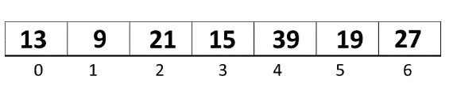
Linear Search-
Example of Linear Search Algorithm
Consider an array of size 7 with elements 13, 9, 21, 15, 39, 19, and 27
Search element = 39

Slide 4
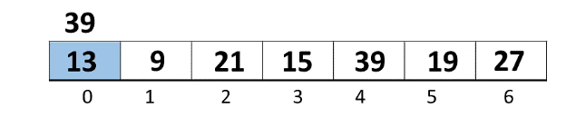
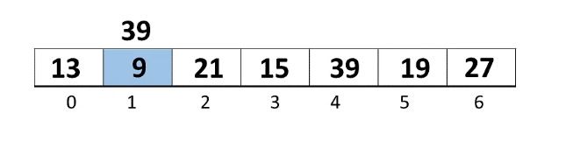
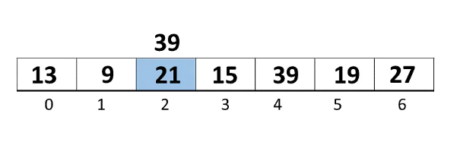
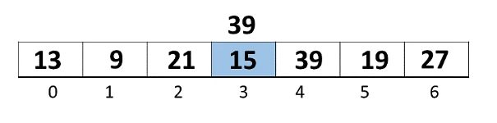

Slide 5
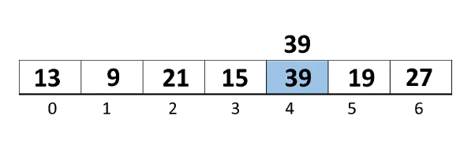
You have three different complexities faced while performing Linear Search Algorithm, they are mentioned as follows.
Best Case
Worst Case
Average Case

Slide 6
Best Case Complexity
The element being searched could be found in the first position.
In this case, the search ends with a single successful comparison.
Thus, in the best-case scenario, the linear search algorithm performs O(1) operations.

Slide 7
Worst Case Complexity
The element being searched may be at the last position in the array or not at all.
In the first case, the search succeeds in ‘n’ comparisons.
In the next case, the search fails after ‘n’ comparisons.
Thus, in the worst-case scenario, the linear search algorithm performs O(n) operations.

Slide 8
Average Case Complexity
When the element to be searched is in the middle of the array, the average case of the Linear Search Algorithm is O(n).
Next, you will learn about the Space Complexity of Linear Search Algorithm.

Slide 9
Space Complexity of Linear Search Algorithm
The linear search algorithm takes up no extra space; its space complexity is O(n) for an array of n elements.

Slide 10
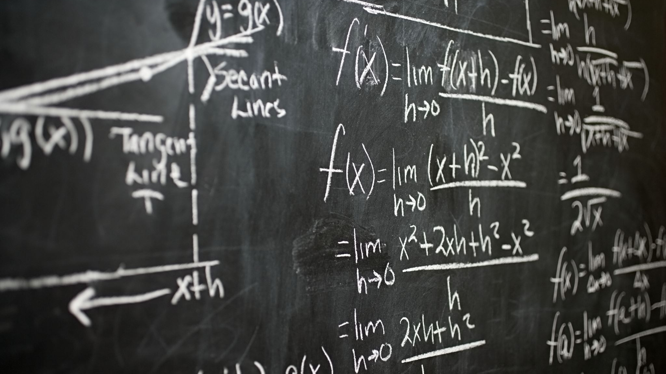
Asymptotic Notation

Slide 11
Asymptotic notations are mathematical notations that are used to analyze the runtime of a given algorithm for a large input.
It helps us to compare the runtimes of different algorithms without actually calculating their runtimes manually.
Asymptotic notations are used only for larger inputs.
For smaller inputs, we do not use asymptotic notations since these smaller inputs do not significantly affect the overall runtime of an algorithm.
For example if we want to compare the runtimes of the bubble sort algorithm and merge sort algorithm, we can use asymptotic notations to do this comparison.

Slide 12

Growth of Functions
functions that map input size to (typically, worst-case) running time/space cost.
Termed as “asymptotic growth” of functions.
focus - how the function behaves as its input grows large.
describing families of functions that share similar asymptotic behavior.
ignore small input sizes, constant factors, lower-order terms in polynomials, and so forth.
describe how a function grows

Slide 13
Asymptotic Notation
O notation:
Ω notation:
Θ notation:
little “oh”
little omega

Slide 14
Big -O notation
asymptotic upper bound of this function Ie: worst case
Most commonly used
f(n)-rate of growth of time of an algorithm for an input n.
FIND another function g(n) such that there exist a value of +ve integer n & n0 and a positive constant c such that f(n)<=C.g(n) ; n>=n0, C>0, n0>=1( in all case)
Then we can write
f(n)= O(g(n))
Hence function g(n) is upper bound for function f(n) and g(n) grows faster than f(n)

Slide 15
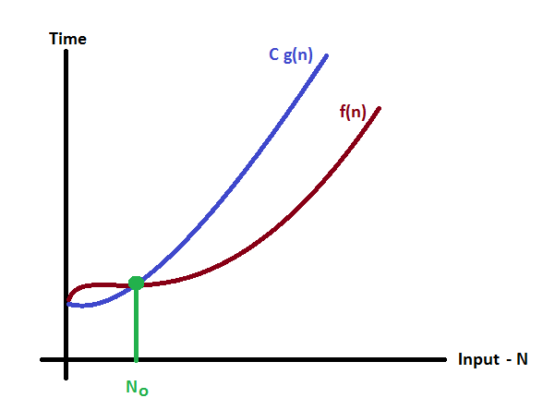
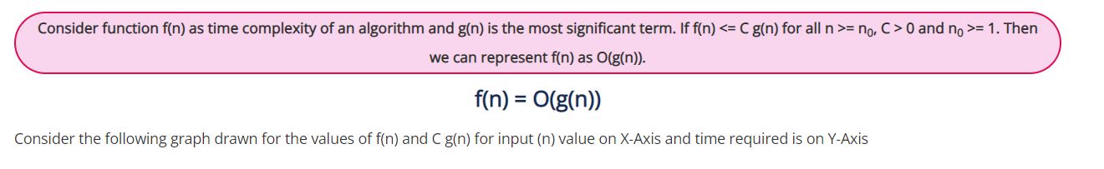
Asymptotic notations-
Big oh- O

Slide 16
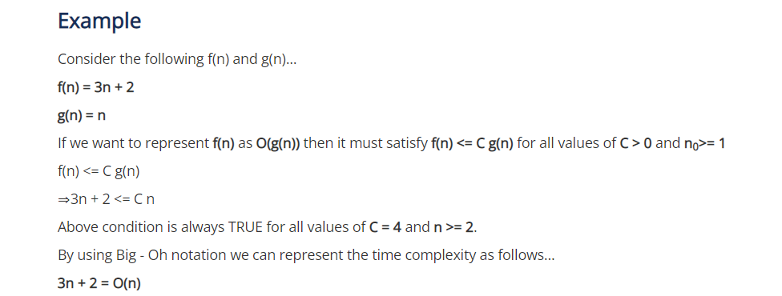
Let f(n)= 3n+2, g(n)= n
Check whether we can write f(n)= O(g(n))

Slide 17
Big Omega Ω - notation
Give lower bound(best case) of an algorithm
Big-Omega notation always indicates the minimum time required by an algorithm for all input values.
That means Big-Omega notation describes the best case of an algorithm time complexity.
Let f(n) & g(n) be two functions
We can write f(n)= Ω g(n)
If f(n)>=c. g(n)
for all c>0 and n >=n0

Slide 18
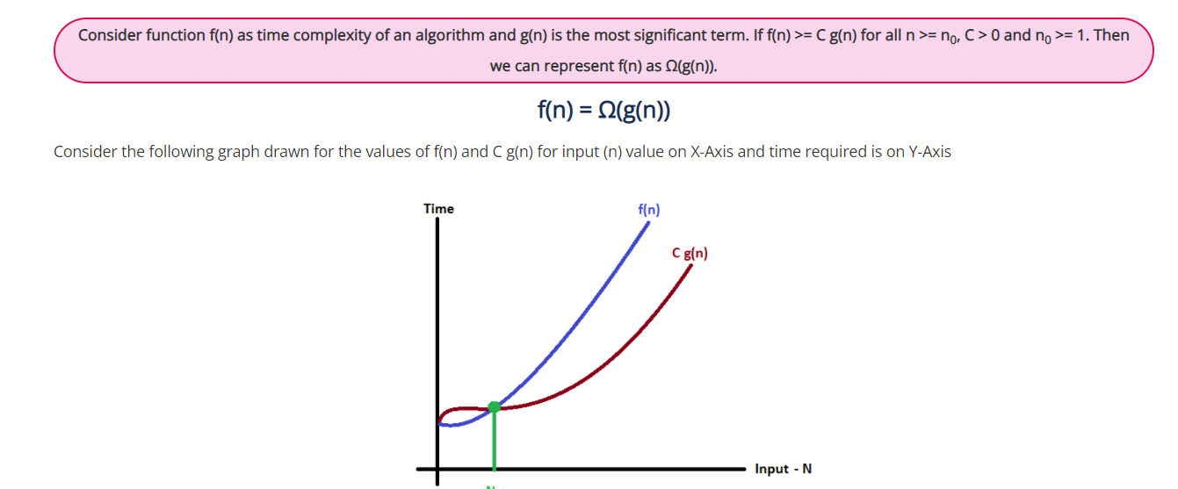

Slide 19
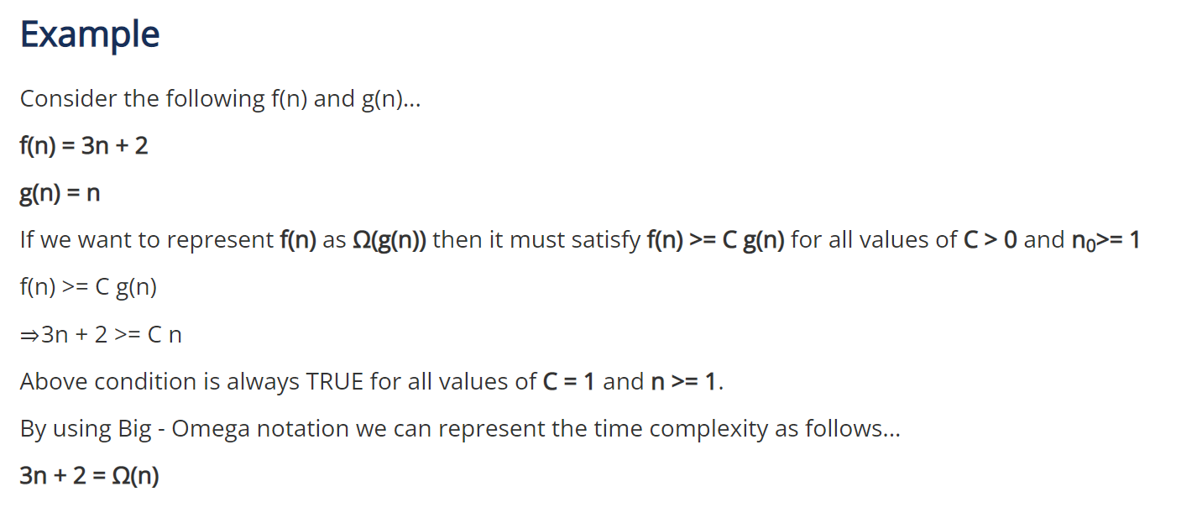

Slide 20
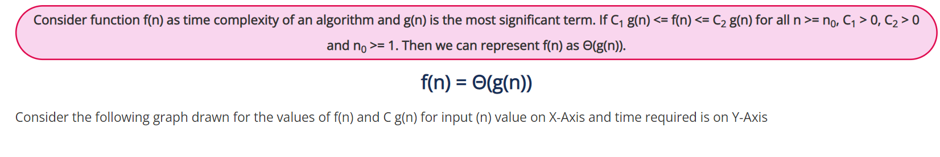
Asymptotic notations (cont.)
Θ-notation
Big - Theta notation is used to define the average bound of an algorithm in terms of Time Complexity.
That means Big - Theta notation always indicates the average time required by an algorithm for all input values.
That means Big - Theta notation describes the average case of an algorithm time complexity.
Big - Theta Notation can be defined as follows...

Slide 21
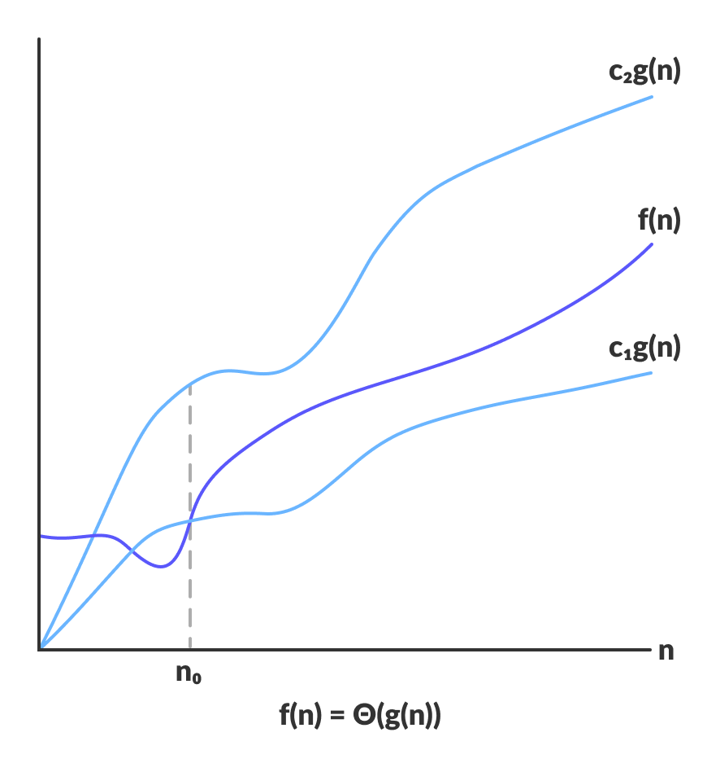

Slide 22
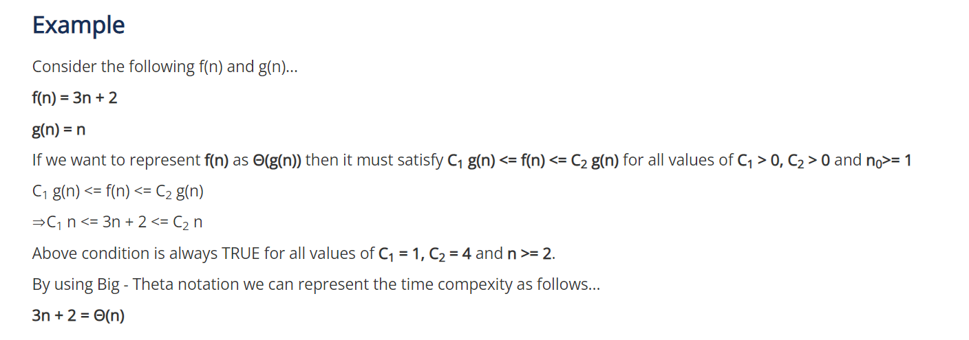

Slide 23
Example
Need to search (linear) n elements in an array
1 ,2,5, 7, 8
Best case x=1 only one comparison,1 step
complexity Ω(1)
Worst case
compare all n elements O(5)
Averagecase Θ(n/2)= Θ(n)

Slide 24


Definition:- [little “oh”] The function f(n) = o(g(n)) (read as “f of n is little oh of g of n”) if and only if
Definition:- [little omega] The function f(n) = ω(g(n)) (read as “f of n is little omega of g of n”) iff

Slide 25
Asymptotic Notation
O notation: asymptotic “less than”:
  f(n)=O(g(n)) implies: f(n) “≤” g(n)
Ω notation: asymptotic “greater than”:
  f(n)= Ω (g(n)) implies: f(n) “≥” g(n)
Θ notation: asymptotic “equality”:
  f(n)= Θ (g(n)) implies: f(n) “=” g(n)

Slide 26
Relationship between o, Θ , Ω
Big O → worst case
Ω → best case
Θ → averagecase
Always Interested in worst case
Average case used when best & worst case same

